Slide 1
Forward and Backward Chaining
Santosh GSK
Industry Expert

Slide 2
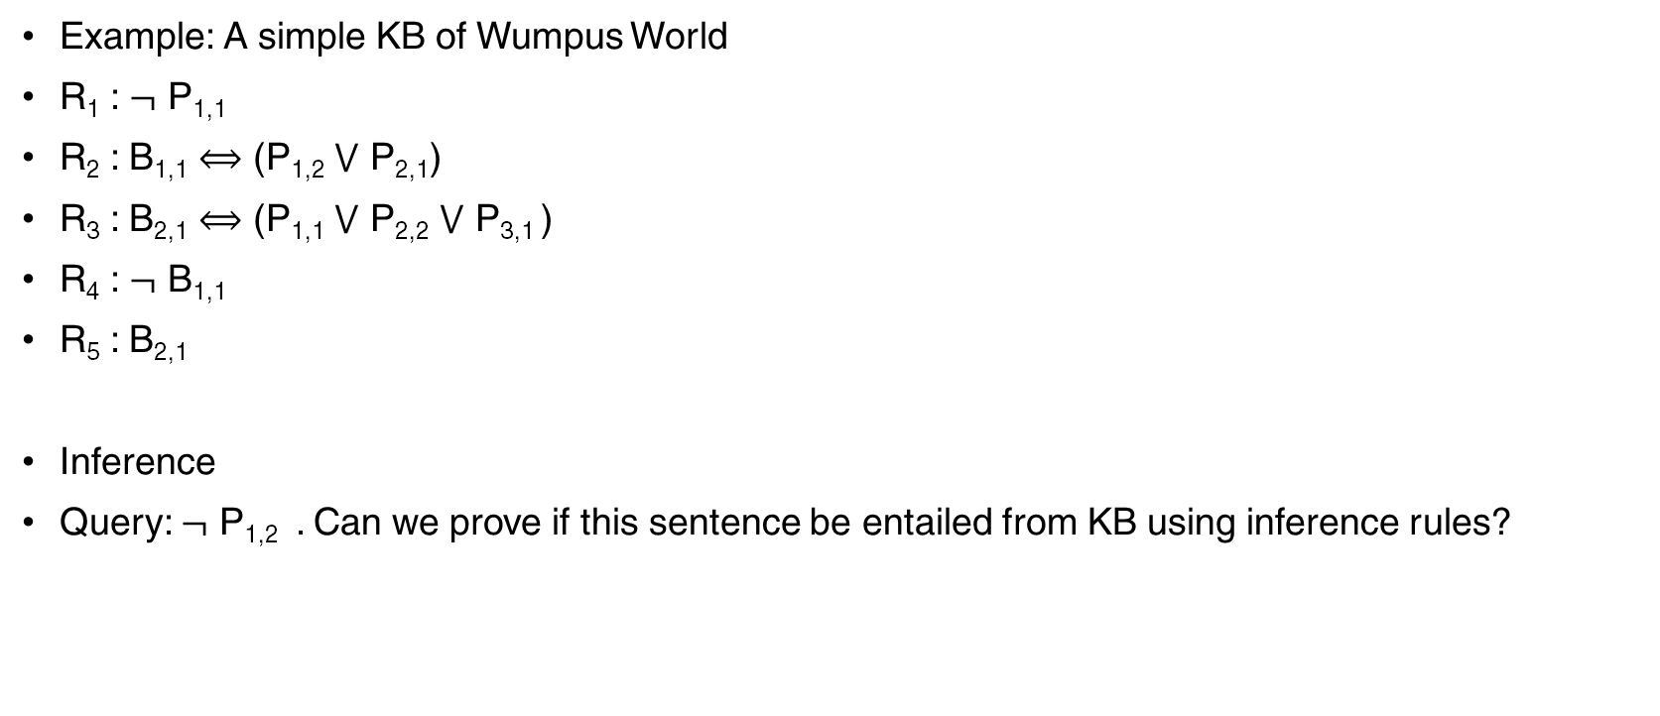
Propositional Logic
Example: A simple KB of Wumpus World
R₁ : $¬$ P_{1,1}
R₂ : B_{1,1} $⟺$ (P_{1,2} $⋁$ P_{2,1})
R₃ : B_{2,1} $⟺$ (P_{1,1} $⋁$ P_{2,2} $⋁$ P_{3,1} )
R₄ : $¬$ B_{1,1}
R₅ : B_{2,1}
Inference
Query: $¬$ P_{1,2} . Can we prove if this sentence be entailed from KB using inference rules?

Slide 3
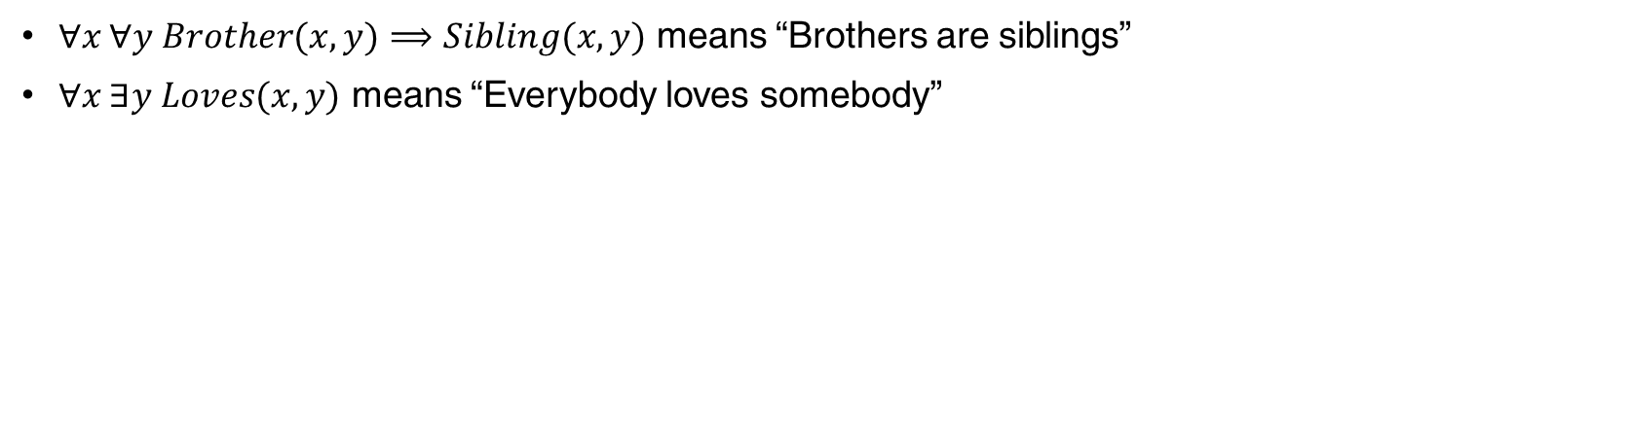
First Order Logic – Syntax
$∀x ∀y Brother(x,y)⟹Sibling(x, y)$ means “Brothers are siblings”
$∀x ∃y Loves(x, y)$ means “Everybody loves somebody”

Slide 4
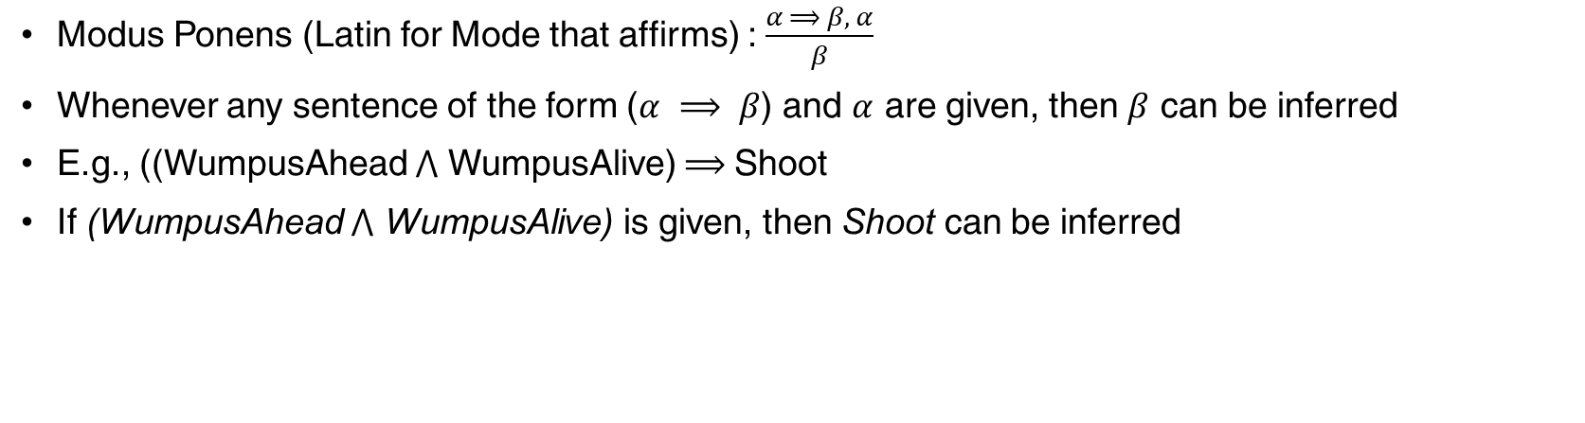
Modus Ponens
Modus Ponens (Latin for Mode that affirms) : $\frac{α ⟹ β, α}{β}$
Whenever any sentence of the form ($α ⟹ β$) and $α$ are given, then $β$ can be inferred
E.g., ((WumpusAhead $⋀$ WumpusAlive) $⟹$Shoot
If (WumpusAhead $⋀$ WumpusAlive) is given, then Shoot can be inferred

Slide 5
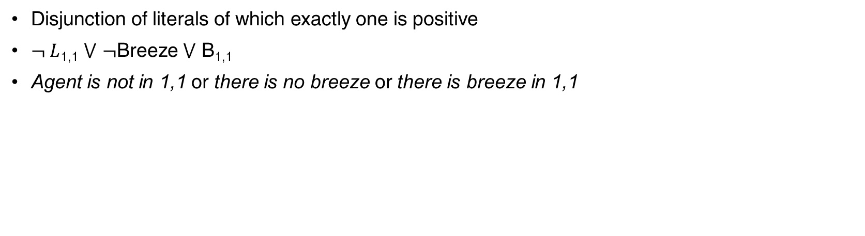
Definite Clause
Disjunction of literals of which exactly one is positive
$¬ L$_{1,1} $⋁$ $¬$Breeze $⋁$ B_{1,1}
Agent is not in 1,1 or there is no breeze or there is breeze in 1,1

Slide 6
Horn Clause
More general than Definite Clause
Disjunction of literals where at most one is positive

Slide 7
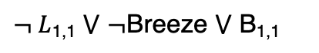
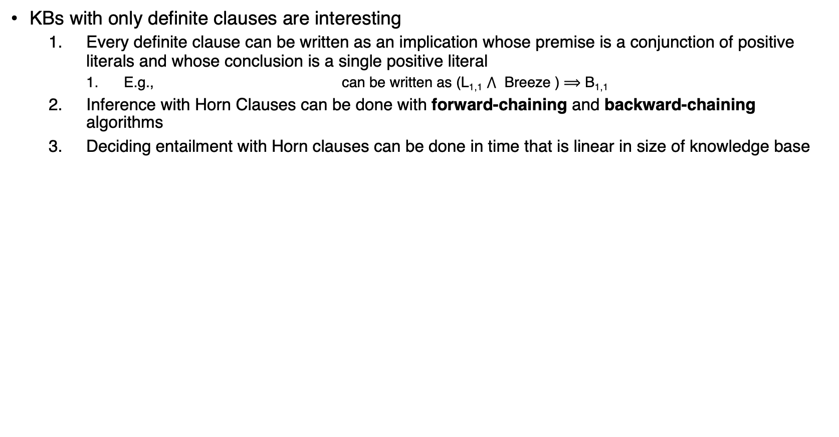
Benefit of Definite Clause
KBs with only definite clauses are interesting
Every definite clause can be written as an implication whose premise is a conjunction of positive literals and whose conclusion is a single positive literal
E.g., can be written as (L_{1,1} $⋀$ Breeze ) $⟹$ B_{1,1}
Inference with Horn Clauses can be done with forward-chaining and backward-chaining algorithms
Deciding entailment with Horn clauses can be done in time that is linear in size of knowledge base
$¬ L$_{1,1} $⋁$ $¬$Breeze $⋁$ B_{1,1}

Slide 8
Forward Chaining
Forward Chaining for PL:
Start with atomic sentences in KB
Apply Modus Ponens in the forward direction, adding new atomic sentences
Repeat above step until no further inferences can be made
Forward Chaining for FOL:
Unlike PL, FOL include variables, in which case those variables are assumed to be universally quantified

Slide 9
Example
Consider the following problem:
The law says it is a crime for an American to sell weapons to hostile nations. The country Nono, an enemy of America, has some missiles, and all of its missiles were sold to it by Colonel West, who is American.
We will prove that West is a criminal

Slide 10
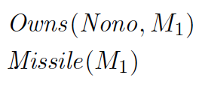
Example – Creating Definite Clauses
First, we will represent the facts in First Order Definite Clauses
“ … it is a crime for an American to sell weapons to hostile nations”
“Nono … has some missiles”
is transformed into two definite clauses by Existential Instantiation

Slide 11
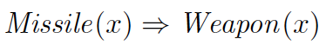
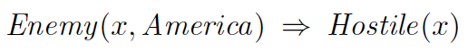
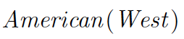
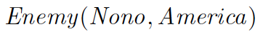
Example – Creating Definite Clauses
“All of its missiles were sold to it by Colonel West”
Missiles are weapons
Hostile means enemy
”West, who is American”
“The country Nono, an enemy of America”

Slide 12
Forward Chaining
Algorithm
Start from the known facts
It triggers all the rules whose premises are satisfied
Add their conclusions to the known facts
The process repeats until the query is answered or no new facts are added

Slide 13
Forward Chaining
FOL-FC-ASK
The implication sentences are
First iteration
The sentence 1 has unsatisfied premises
Sentence 2 is satisfied with {x/M₁}, and Sells(West, M₁, Nono) is added
Sentence 3 is satisfied with {x/M₁}, and Weapon(M₁) is added
Sentence 4 is satisfied with {x/Nono}, and Hostile(Nono) is added
1
2
3
4

Slide 14
Forward Chaining
FOL-FC-ASK
The implication sentences are
Second iteration
Sentence 1 is satisfied with {x/West, y/M₁, z/Nano} and Criminal(West) is added
1
2
3
4

Slide 15
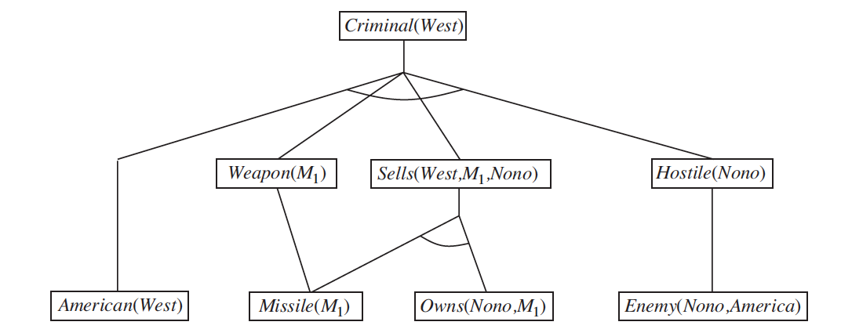
Forward Chaining – Proof Tree

Slide 16
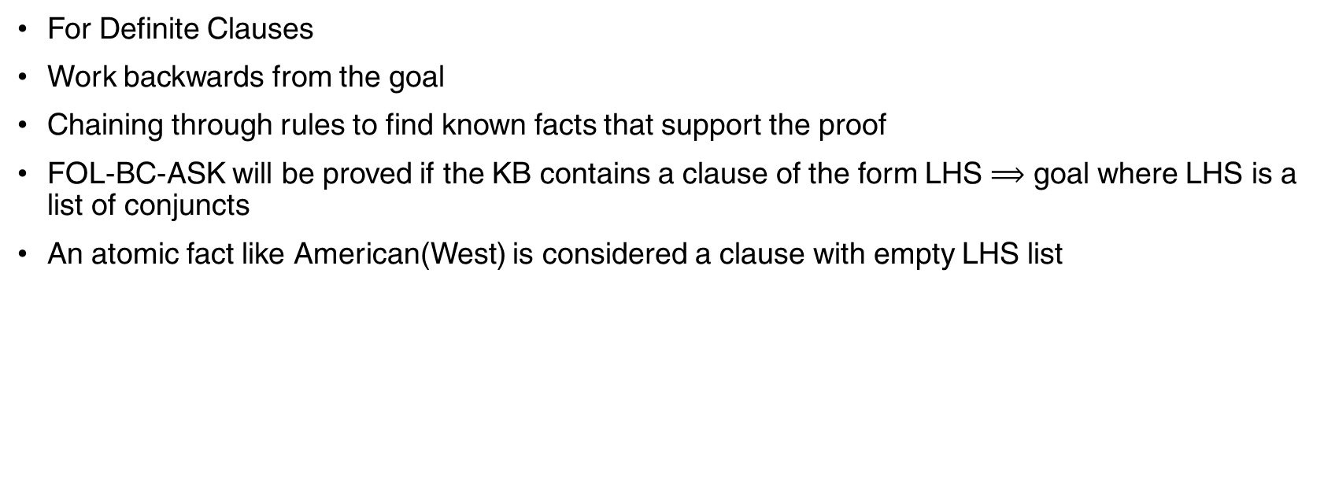
Backward Chaining
For Definite Clauses
Work backwards from the goal
Chaining through rules to find known facts that support the proof
FOL-BC-ASK will be proved if the KB contains a clause of the form LHS $⟹$ goal where LHS is a list of conjuncts
An atomic fact like American(West) is considered a clause with empty LHS list

Slide 17
Backward Chaining
A query with a variable can be proved in multiple ways
E.g., query Person(x) could be proved with {x/John} as well as with {x/Richard}
Hence, we implement FOL-BC-ASK as a generator – multiple return values, each time returning a distinct result

Slide 18
Backward Chaining
Backward Chaining is an AND/OR search
OR – goal query can be proved by any query in the KB
AND – all conjuncts in the LHS must be proved
FOL-BC-OR works by
Fetching all clauses that might unify with goal
Standardizing the variables in the clause to new variables
if RHS in the clause does unify with the goal, then calling FOL-BC-AND to prove every conjunct on LHS
FOL-BC-AND works by
Taking every conjunct one by one and proving it backwards
Keeping track of the accumulated substitution so far

Slide 19
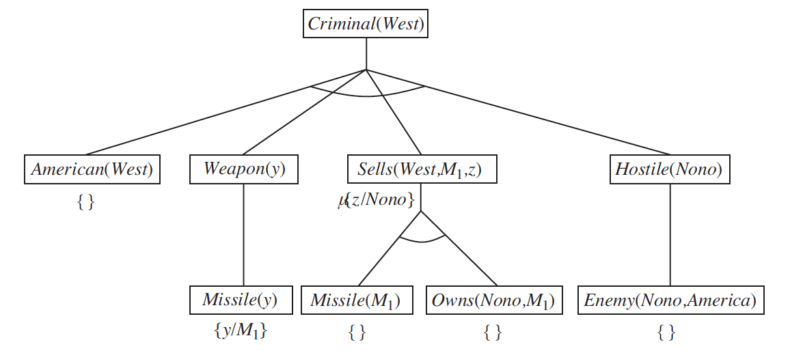
Backward Chaining

Slide 20
Thank You!
In our next session:
Probability & Bayesian Networks

